Slide 1






Case-based Scenario

Slide 2
Managing Sentry
Developers:
Resty S. Aldave
John Wilfred Y.Rama
Clary F. Llaguno
Shan Bagahansol

Slide 3
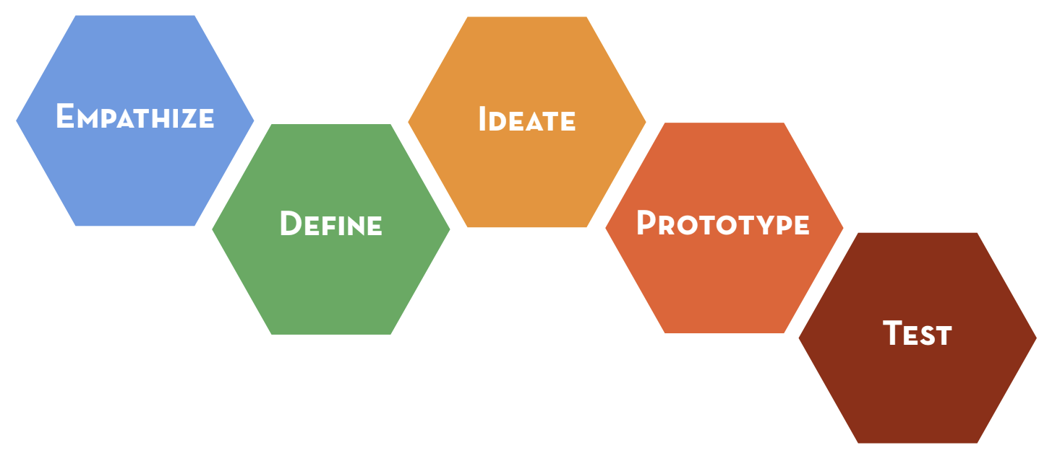
Modes in Design Thinking
Taken from: https://dschool.stanford.edu/

Slide 4
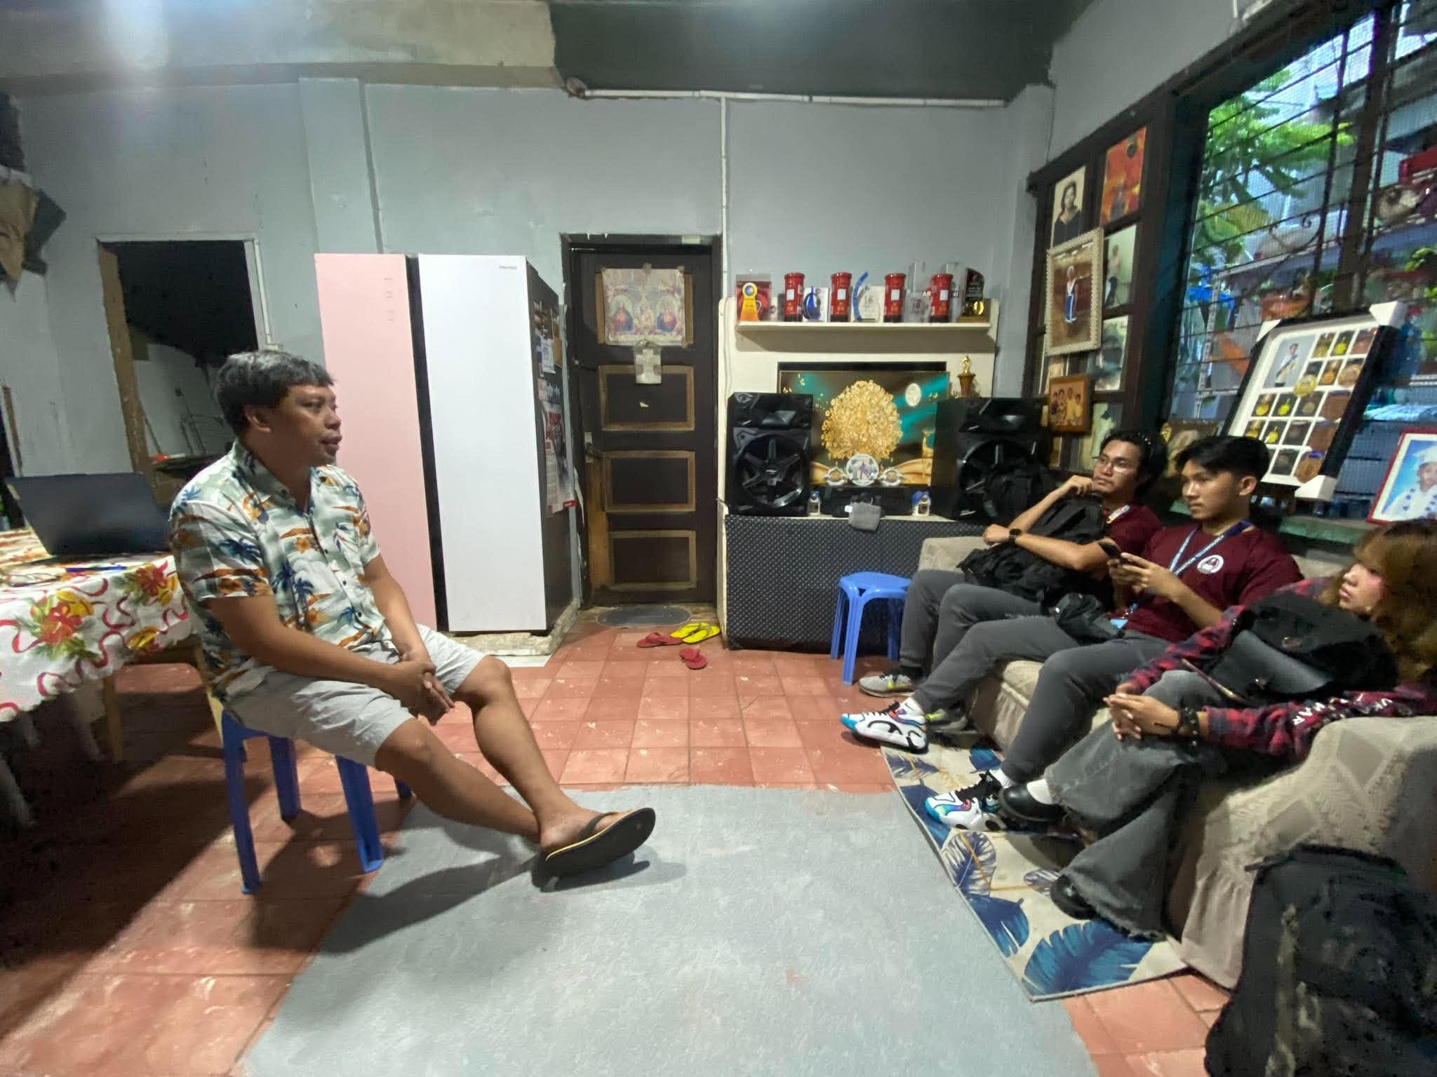
EMPATHIZE
Understanding the client's daily operational challenges through direct interaction.

Slide 5



DEFINE

Slide 6


IDEATE

Slide 7
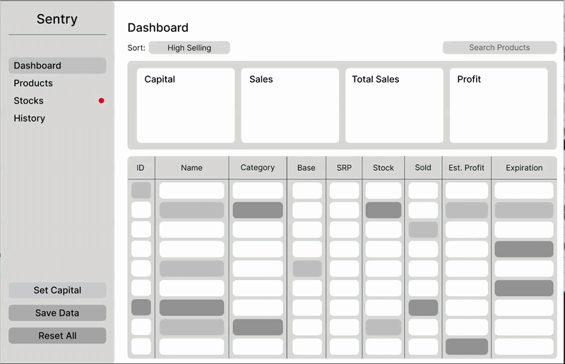
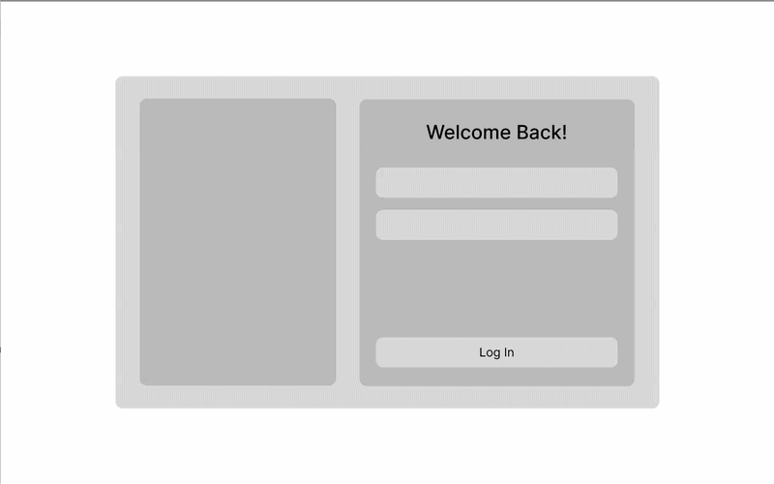
PROTOTYPE/WIREFRAME
App Design
Web Design

Slide 8




TEST

Slide 9
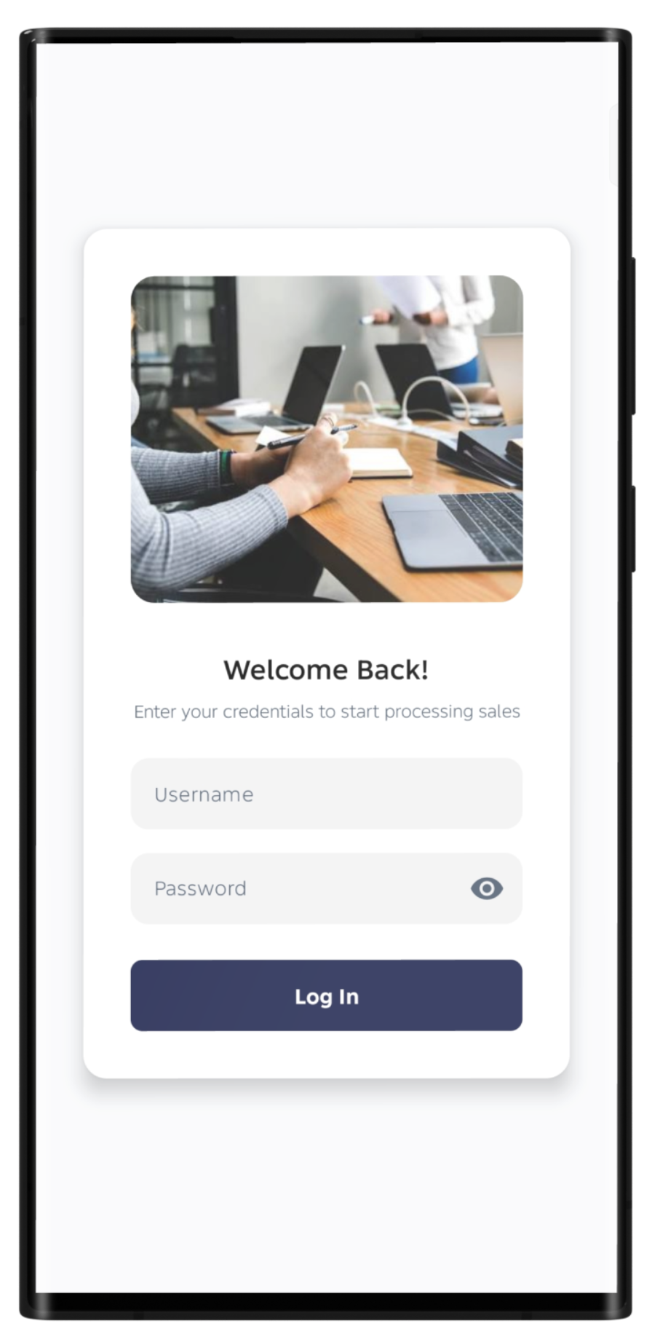
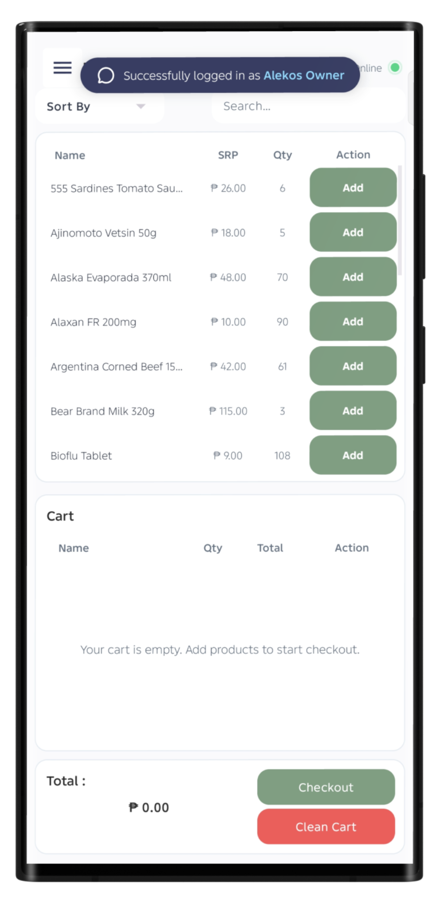
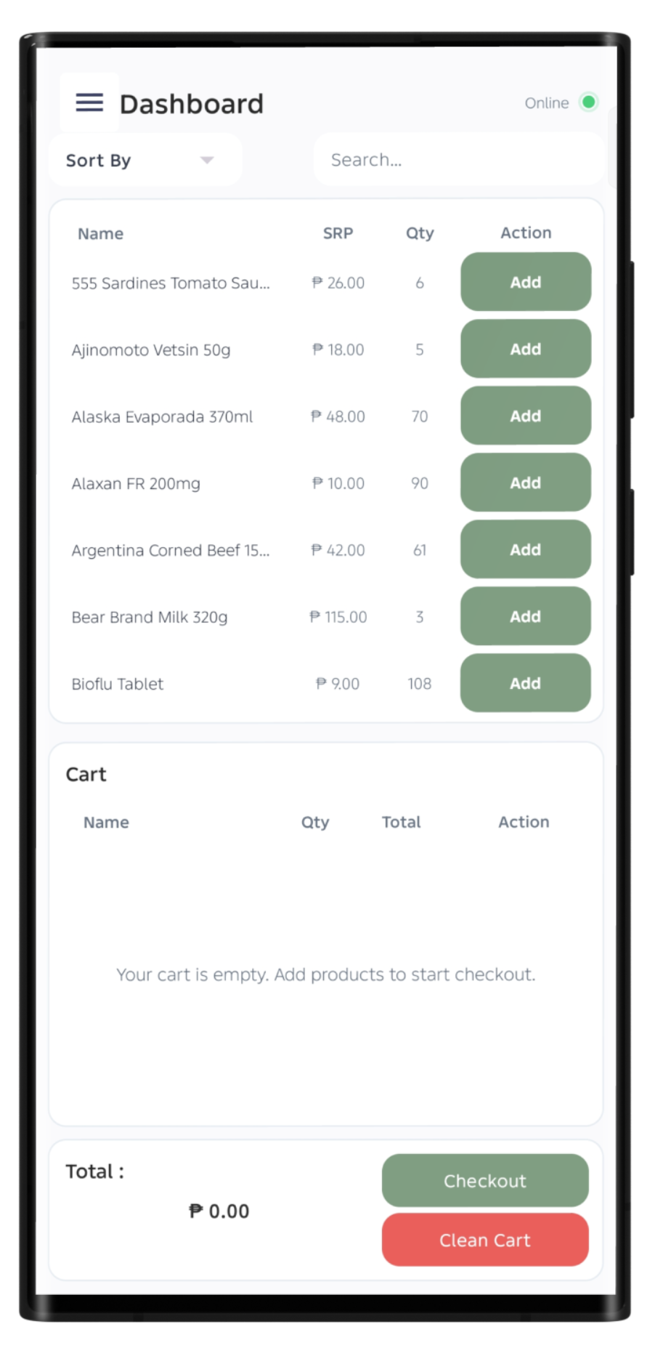
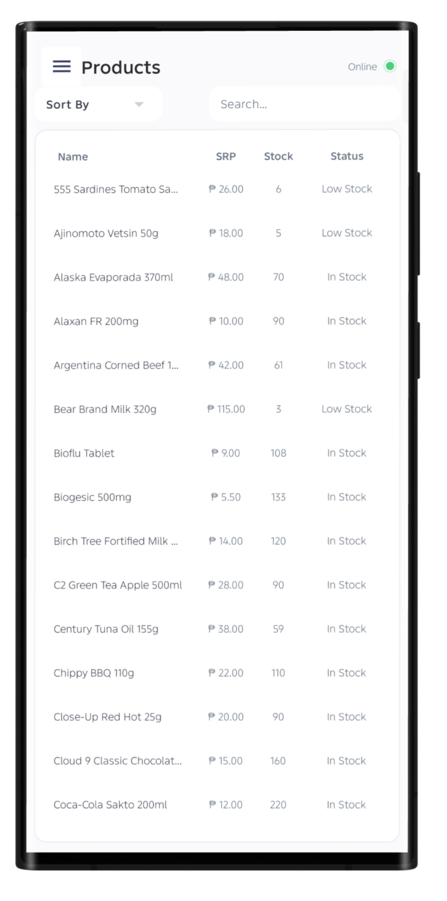
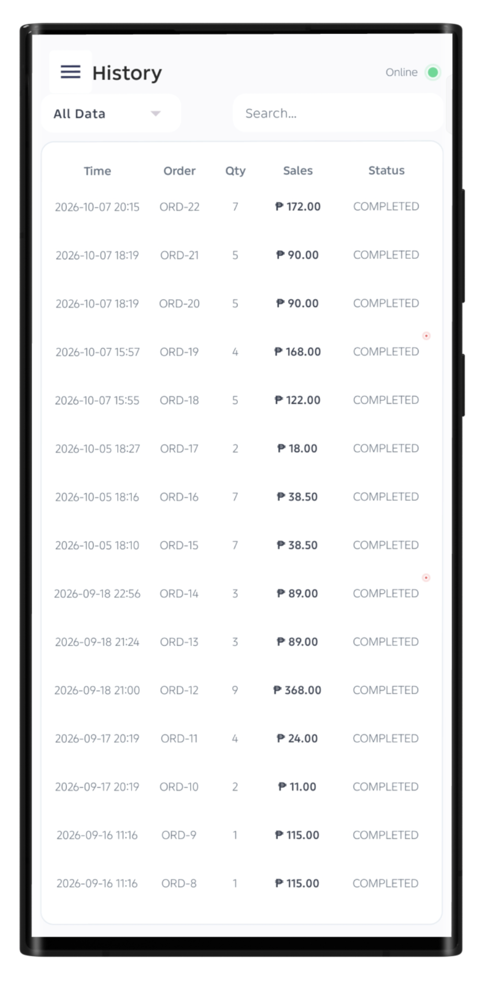
Proposed System and project features(with mockups) “ANDROID”

Slide 10
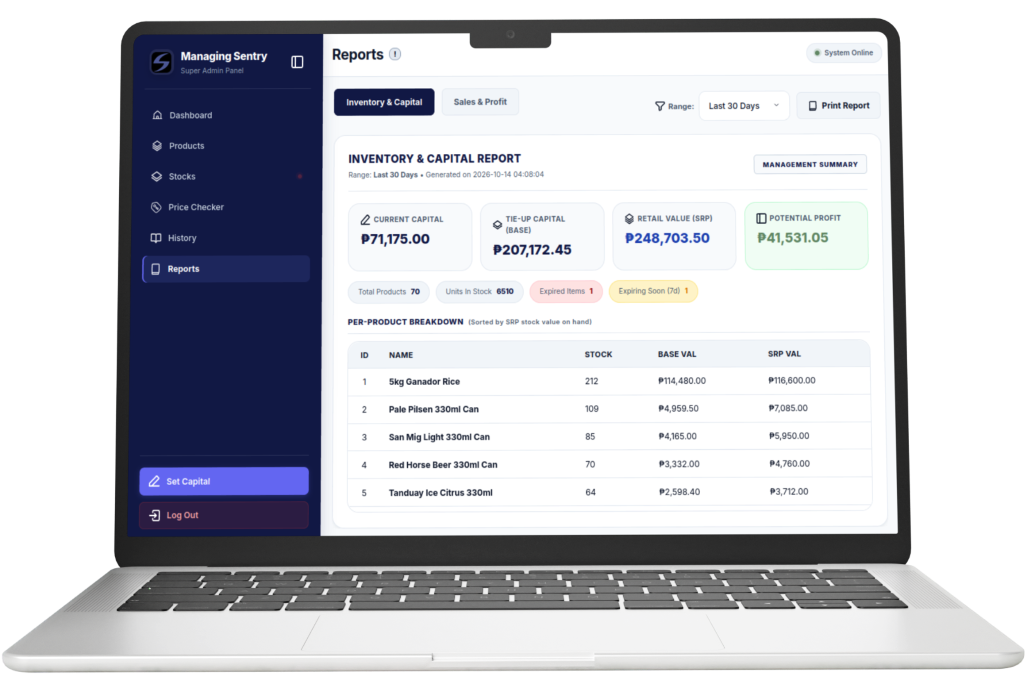
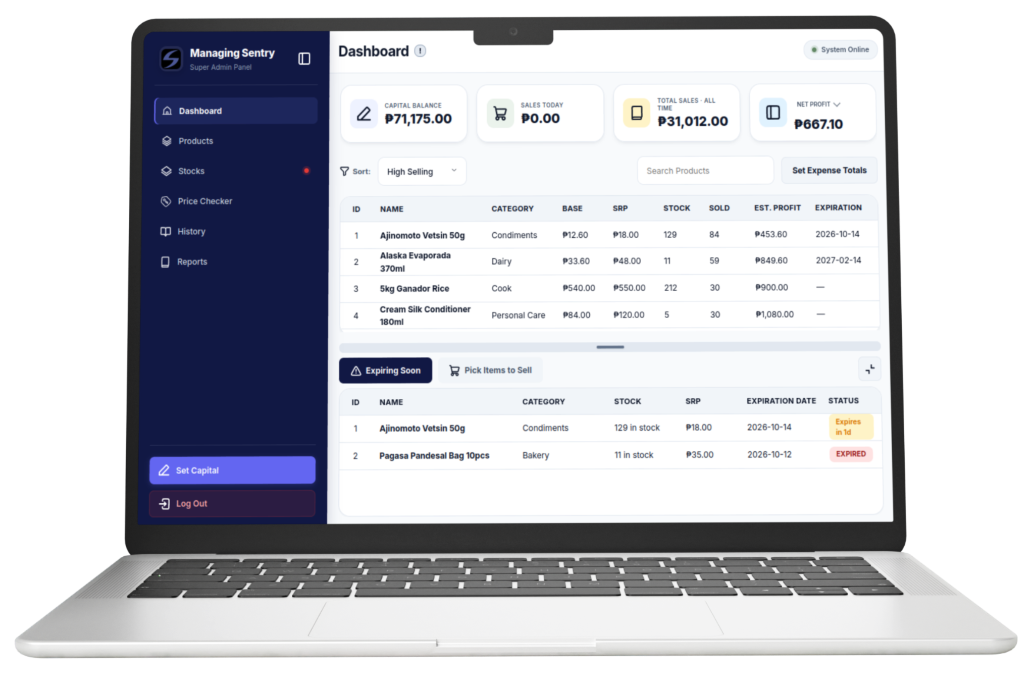
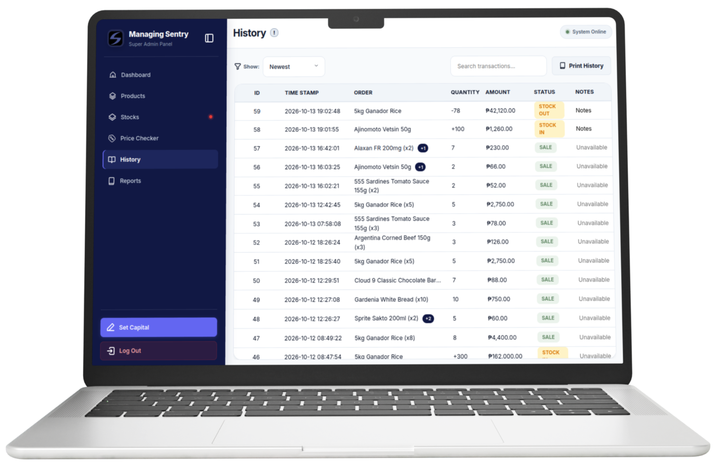
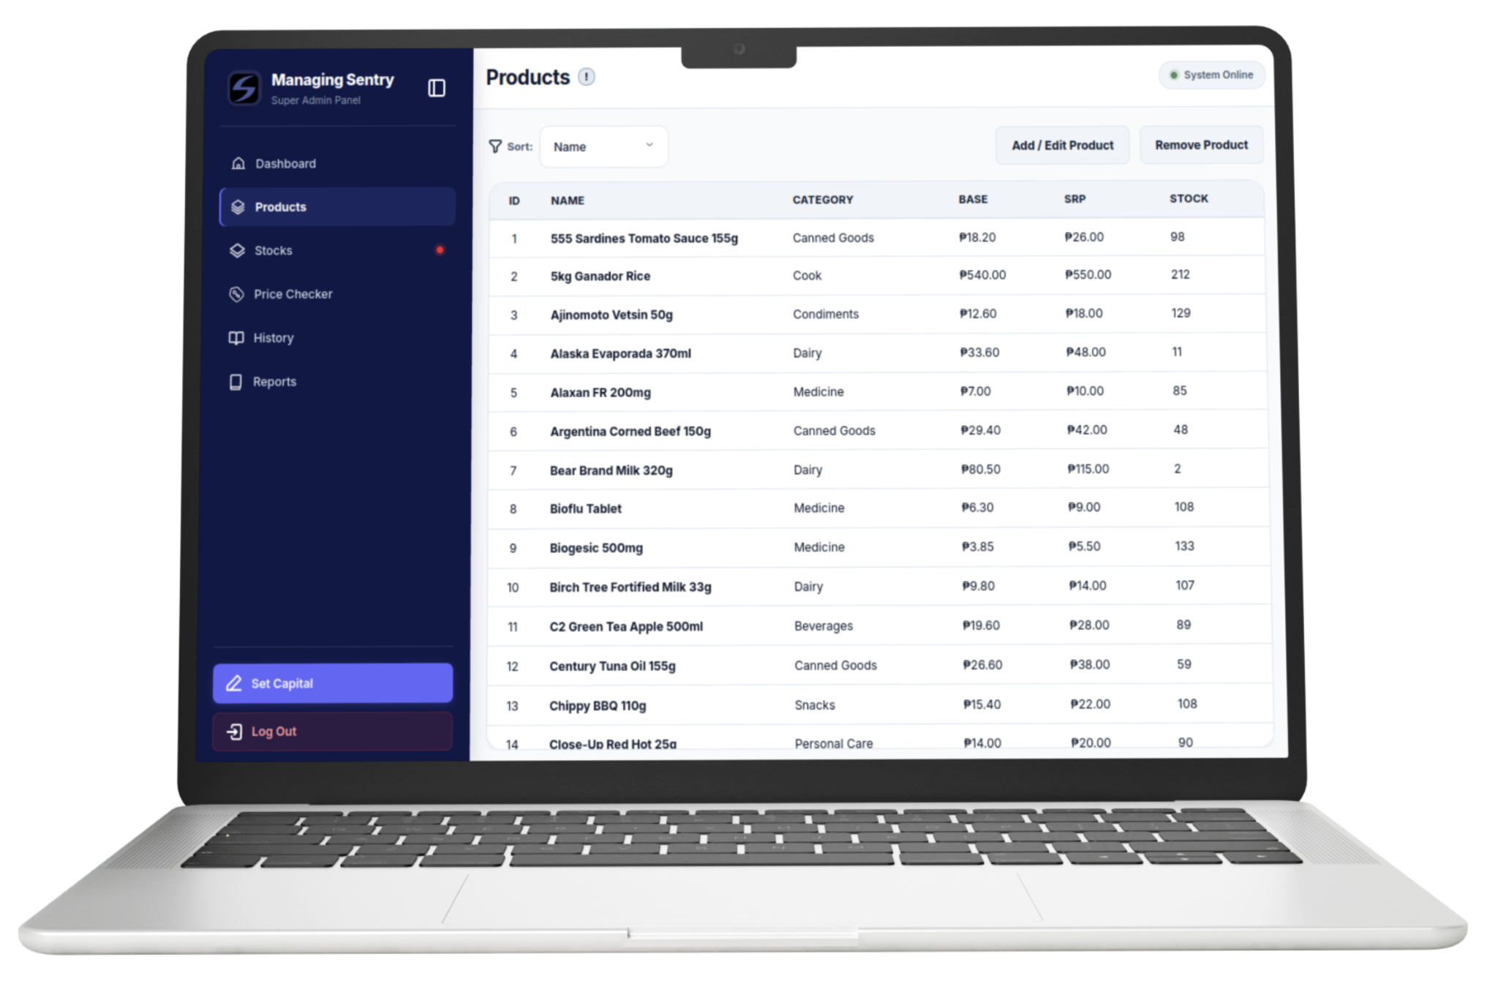
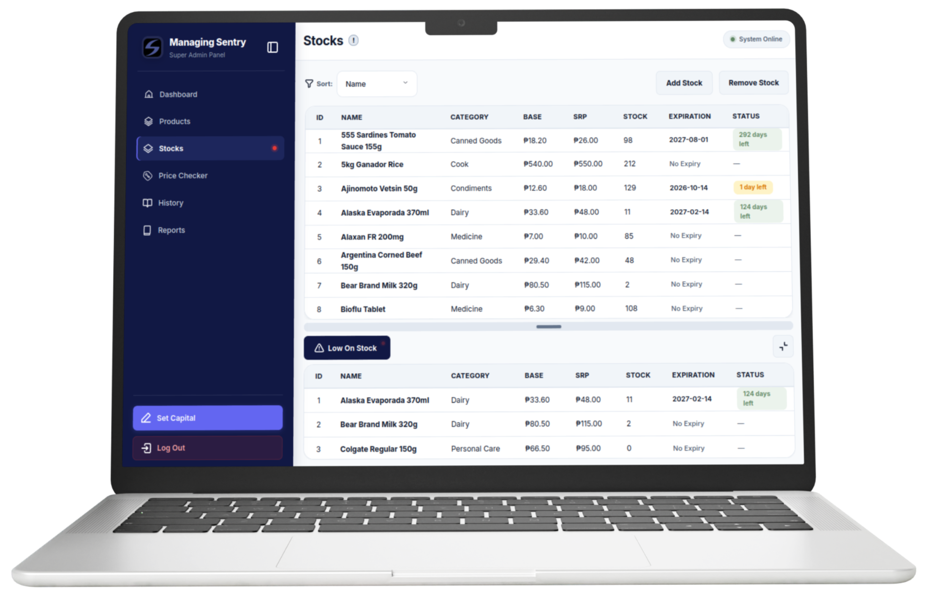
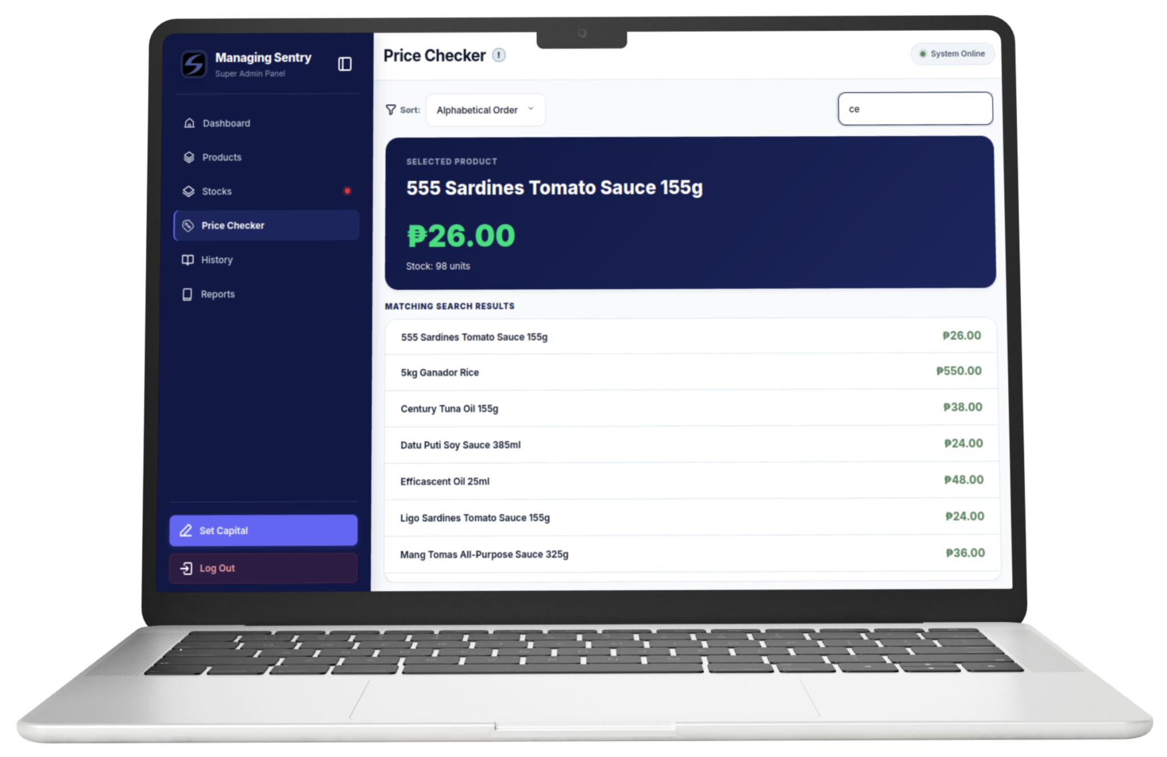
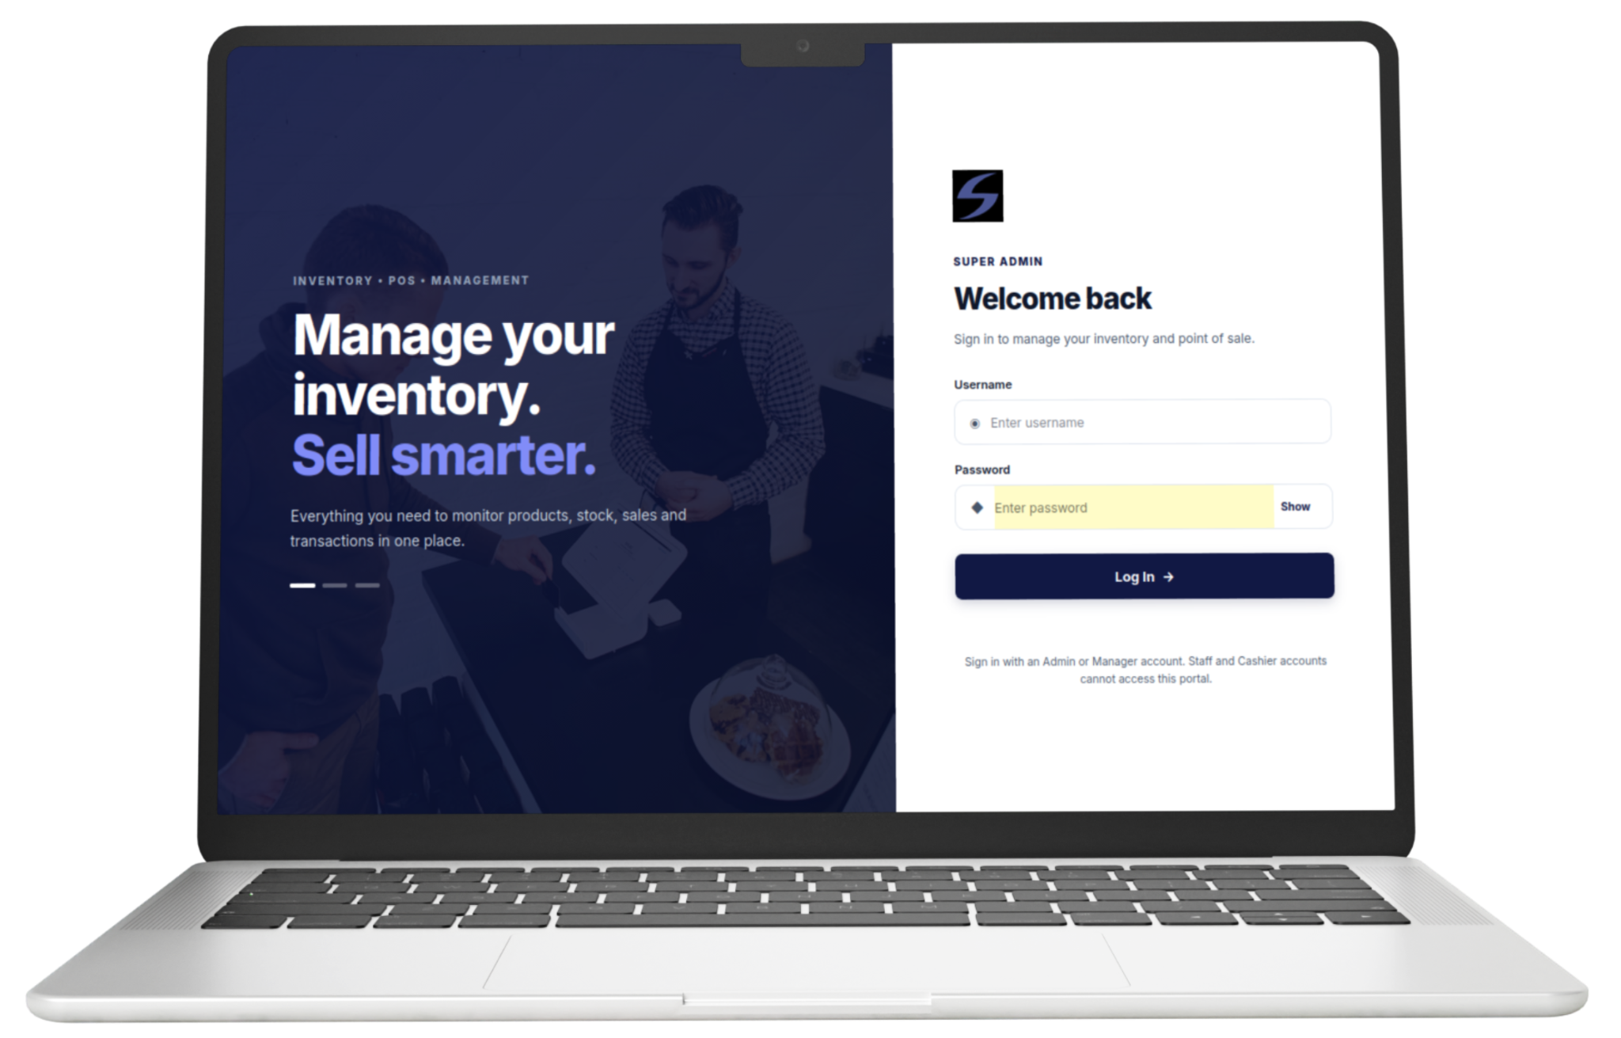
Proposed System and project features(with mockups) “WEBSITE”

Slide 11






Value proposition:

Slide 12






Development platform:

Slide 13
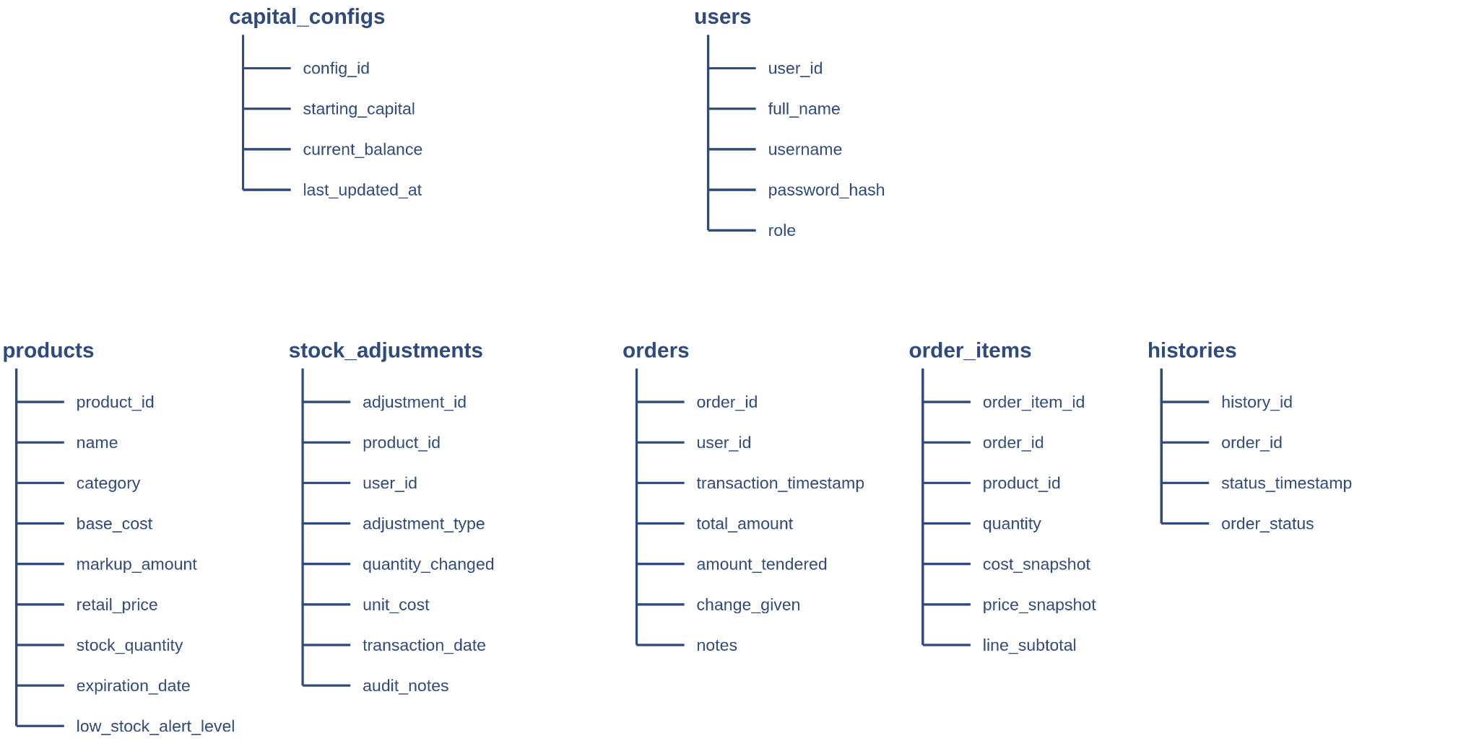
Database Framework

Slide 14
System walkthrough

